Slide 1
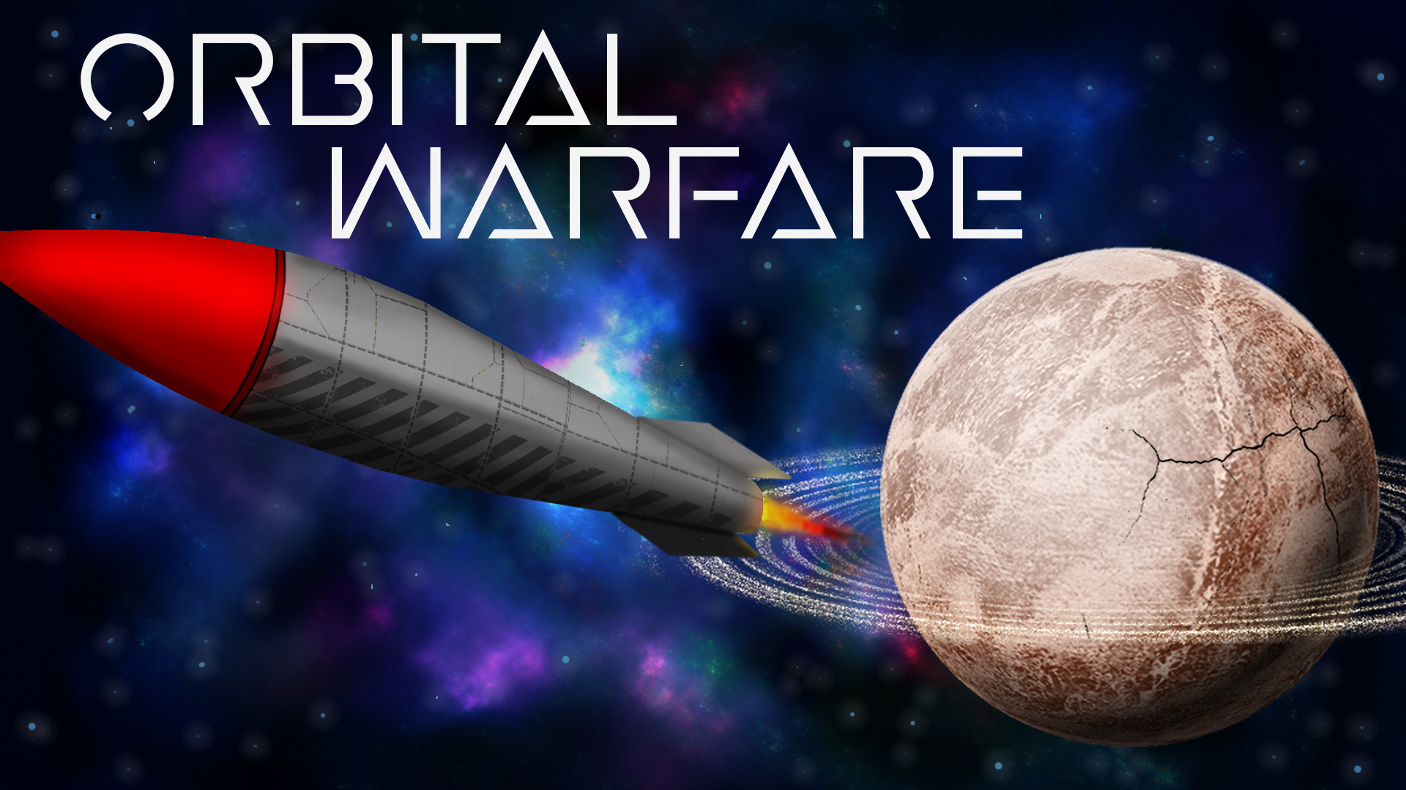
Liam Bakker
Tymon Simonides
Daniel Tarsoly
Martins Avots
Larissa Hartmann

Slide 2
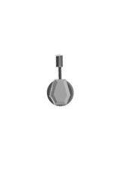
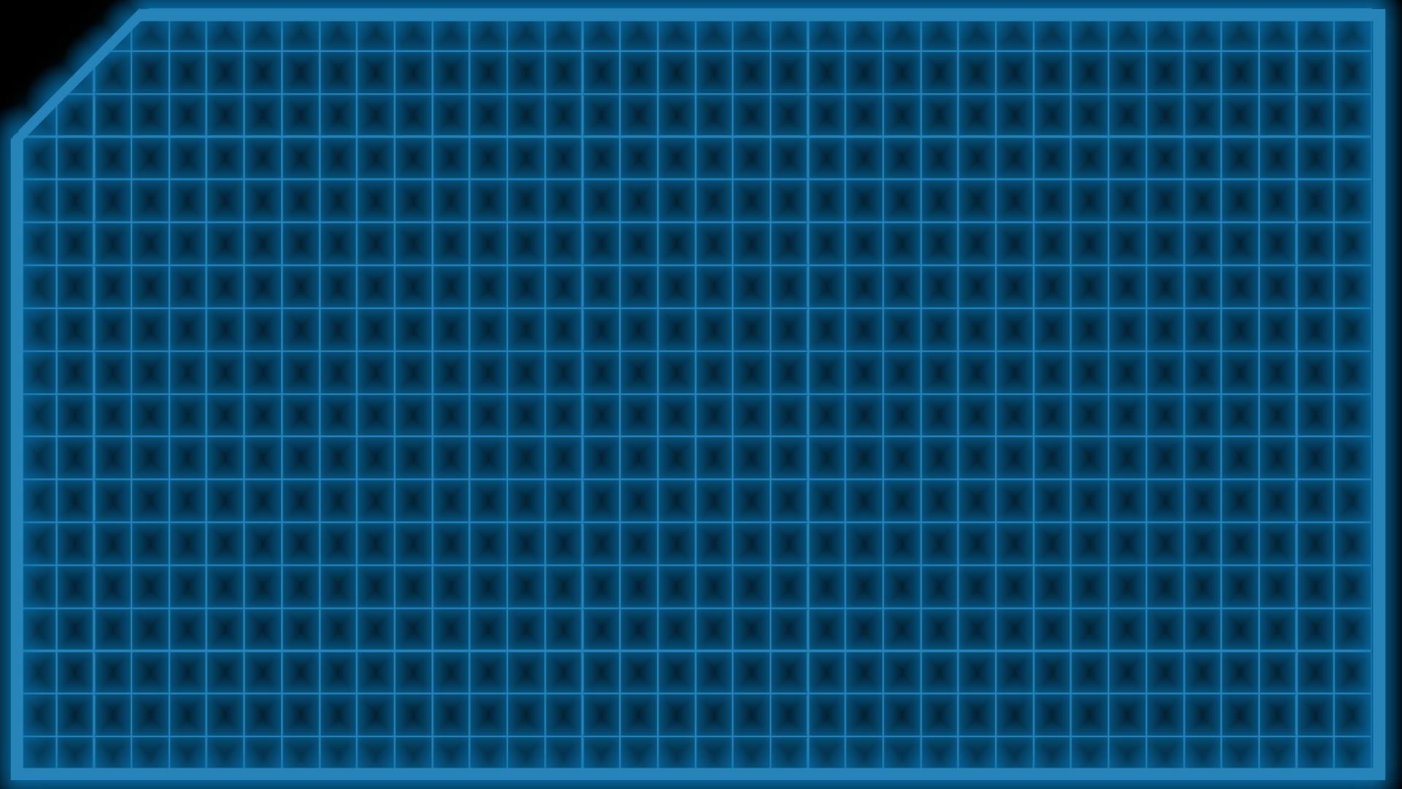
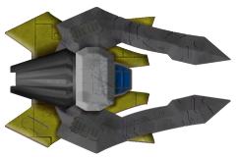
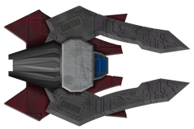
Orbital Warfare is a physics-based game where you and another ‘Captain‘ fight face to face
Genre: Physics-based, action
Target audience: 12+

Slide 3
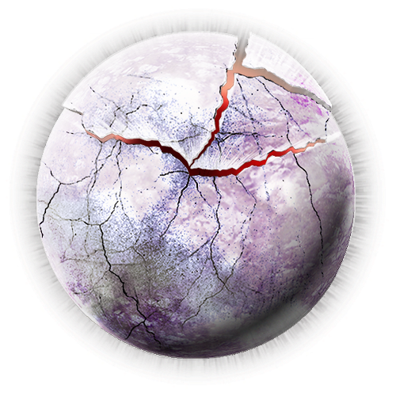

Player versus player
you and you opponent are elite spaceship pilots
Of opposing factions
use gravity of nearby planets to develop your own strategies and gain the upper hand
Buy powerful upgrades to enhance your firepower

Slide 4
Time for a demo

Slide 5

Now The boring stuff

Slide 6
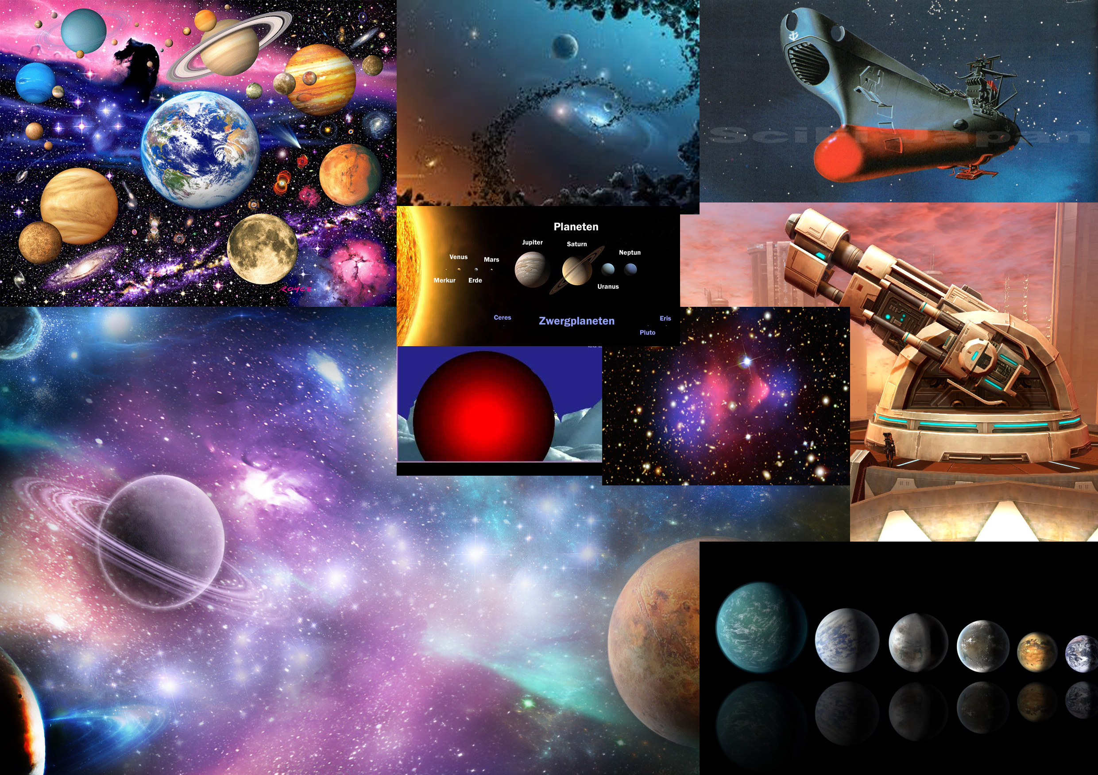
Moodboard

Slide 7
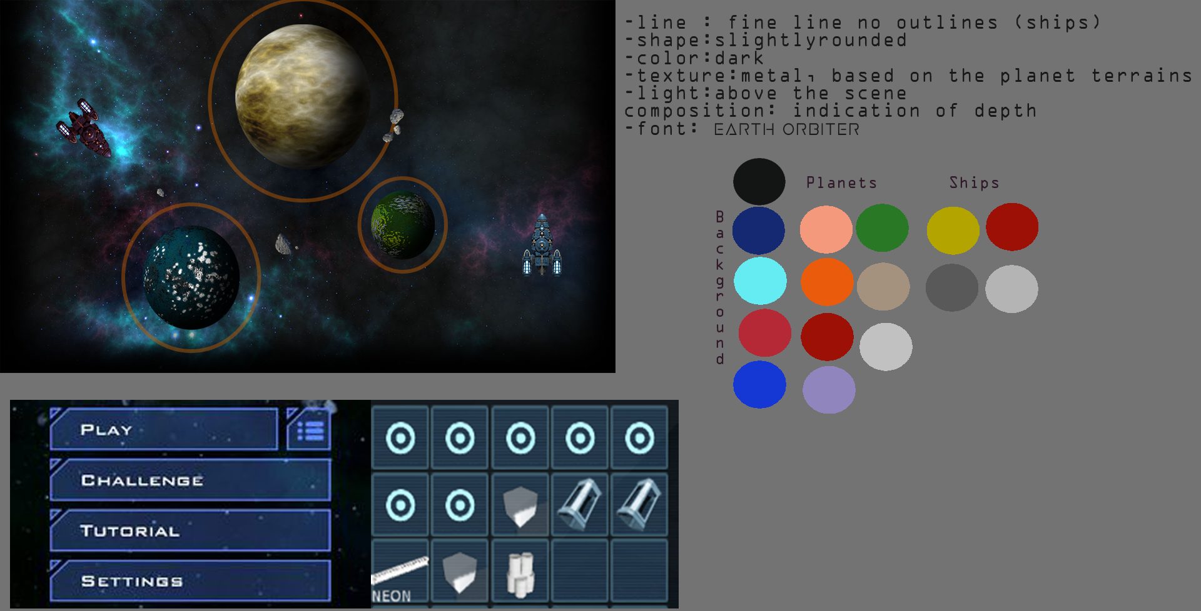
Stylesheet

Slide 8
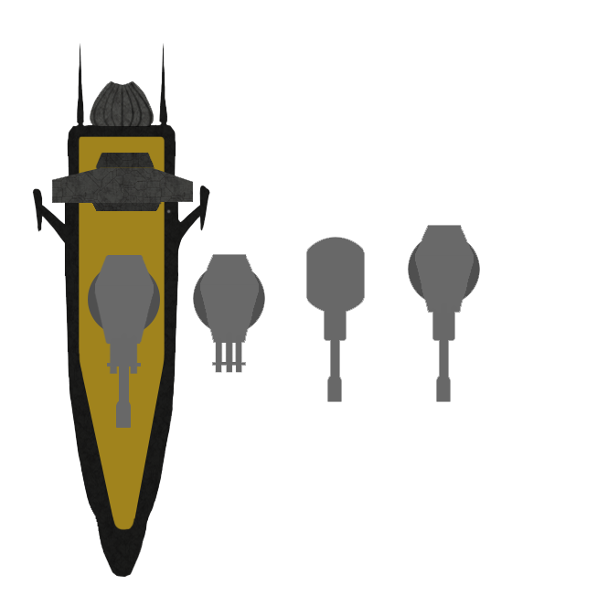

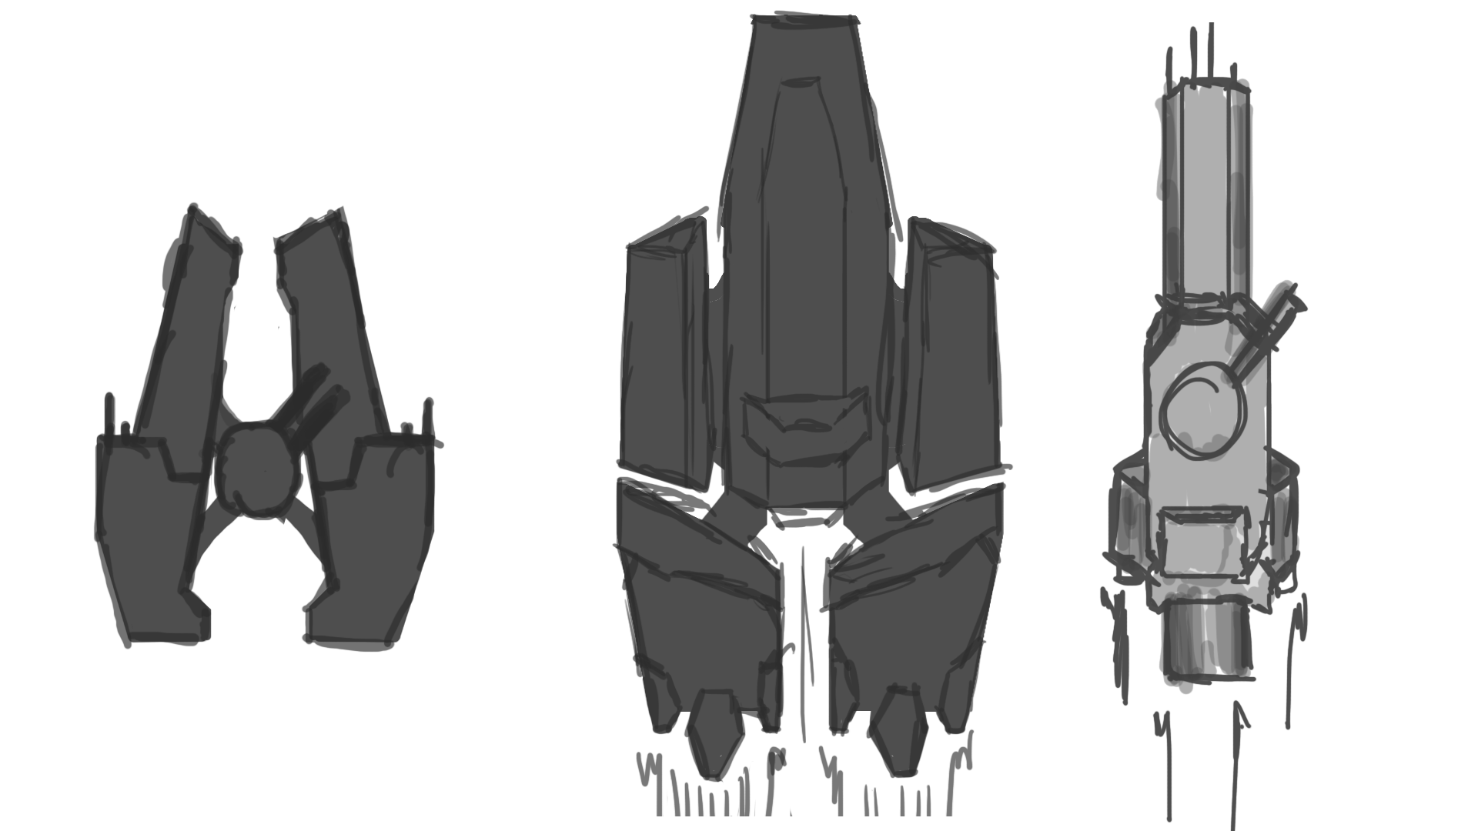
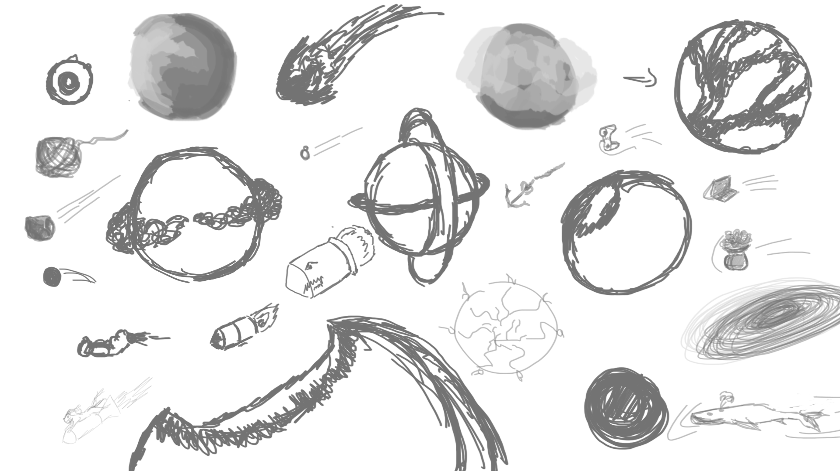
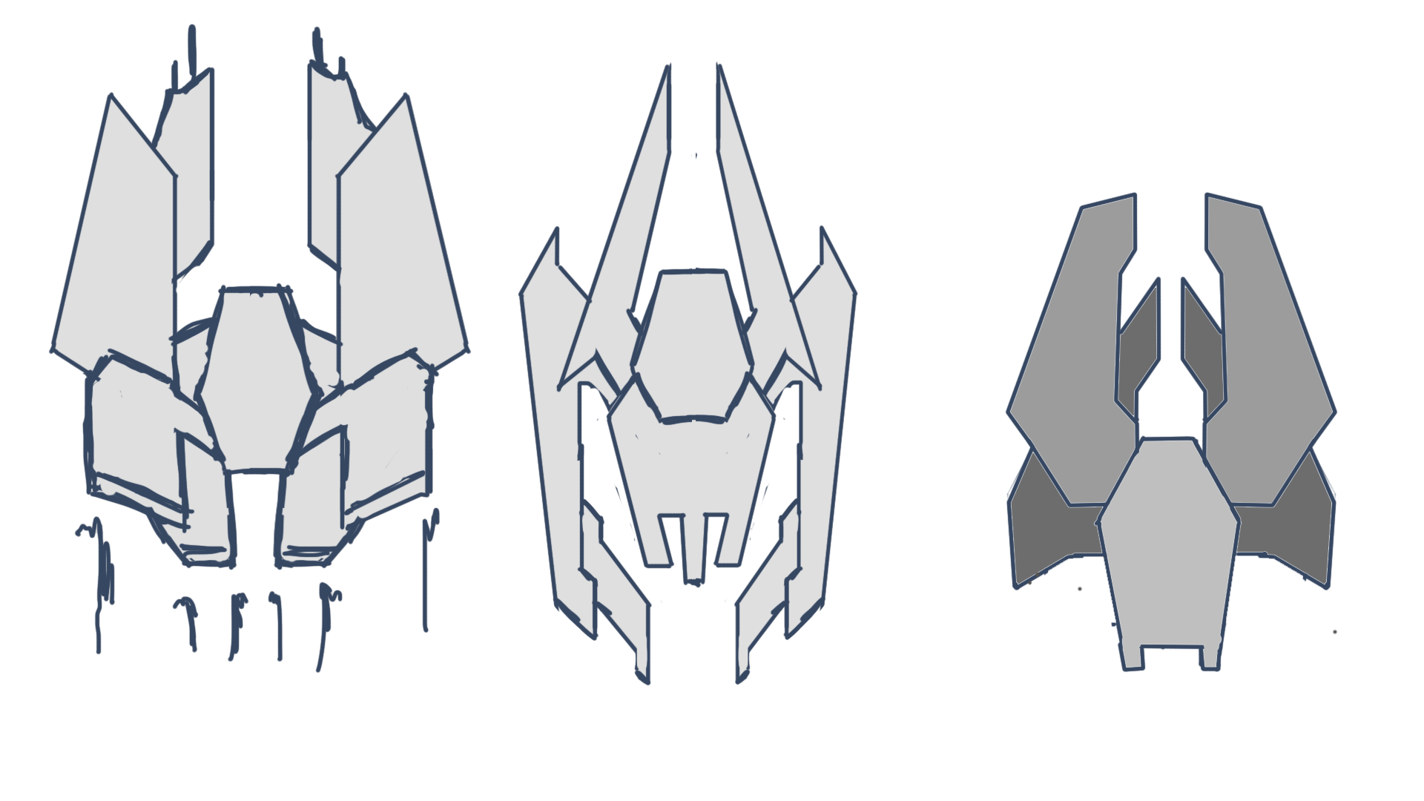
Concept

Slide 9


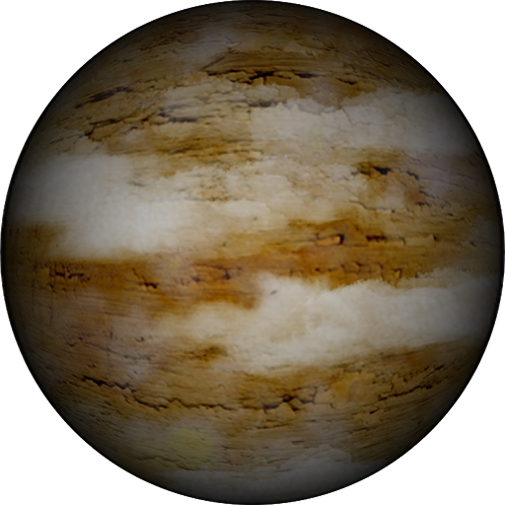
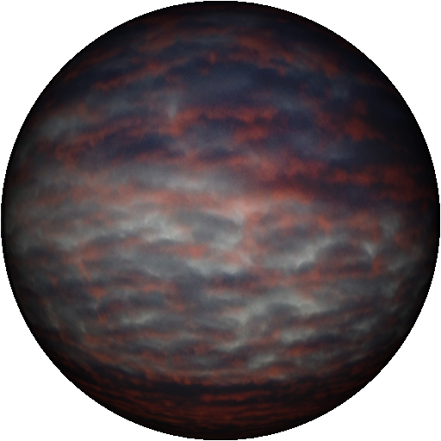


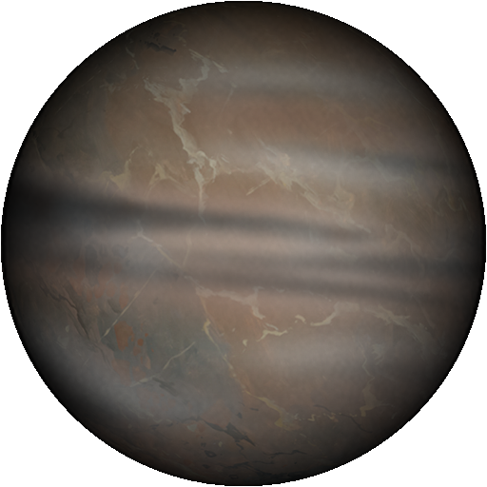
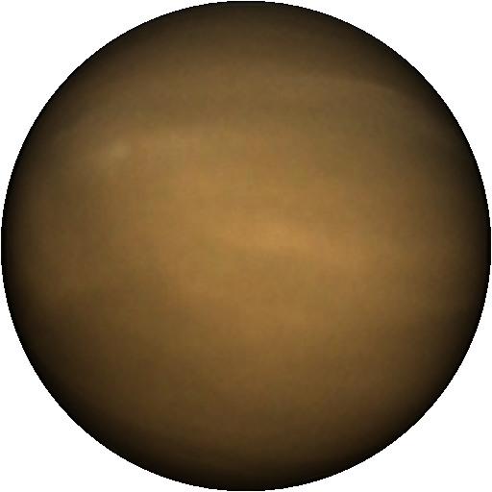


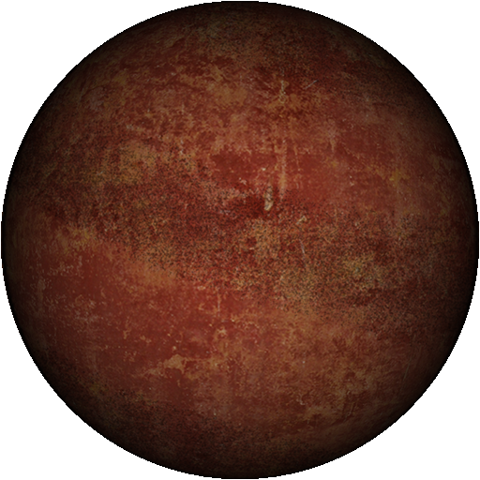
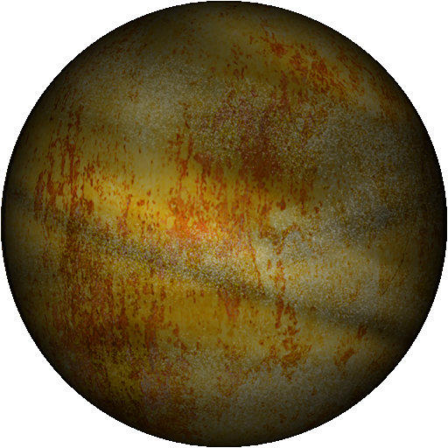
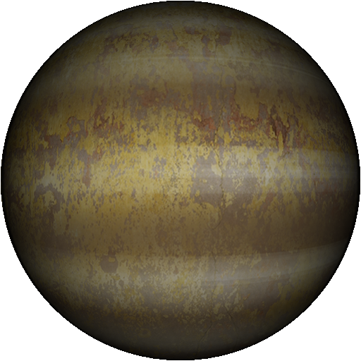
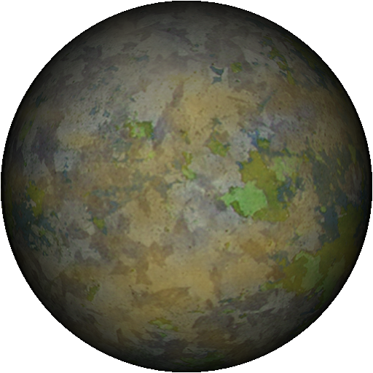
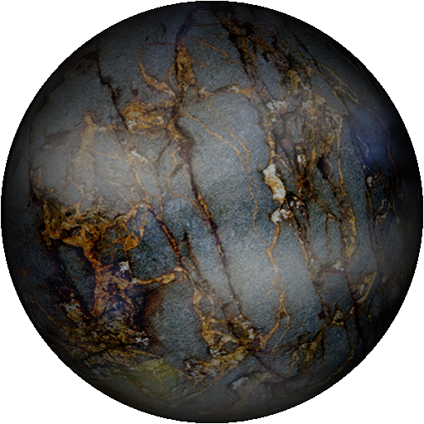




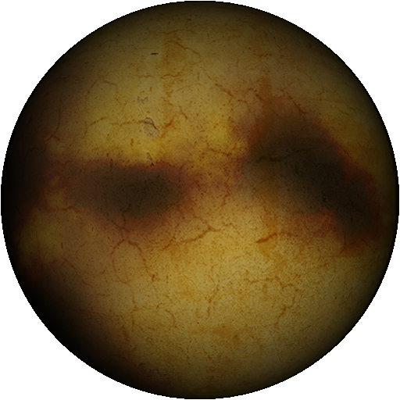
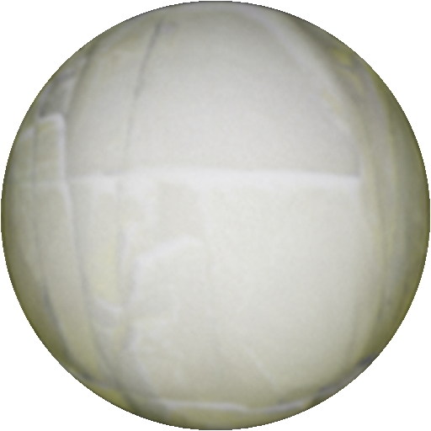



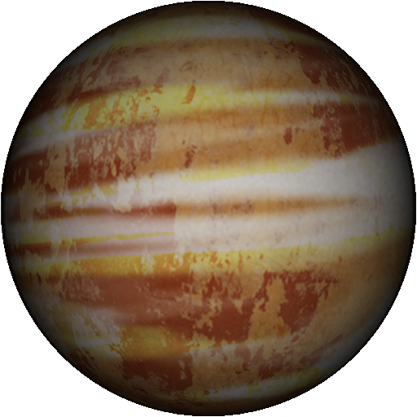
Concept

Slide 10
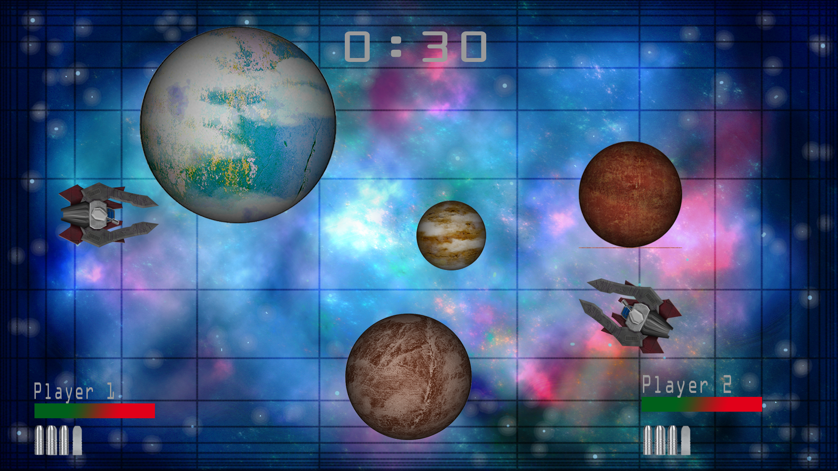
Mockup

Slide 11
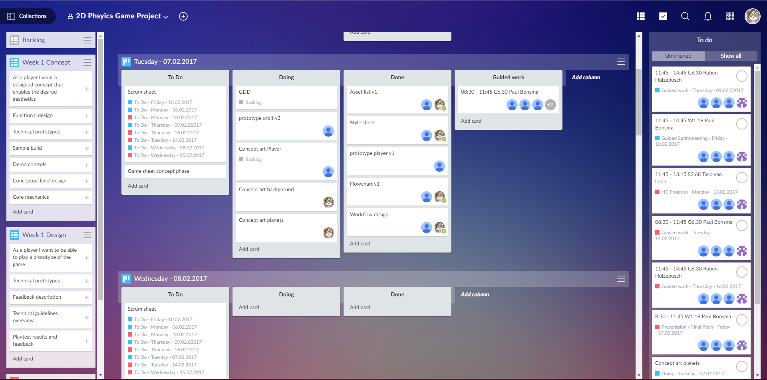
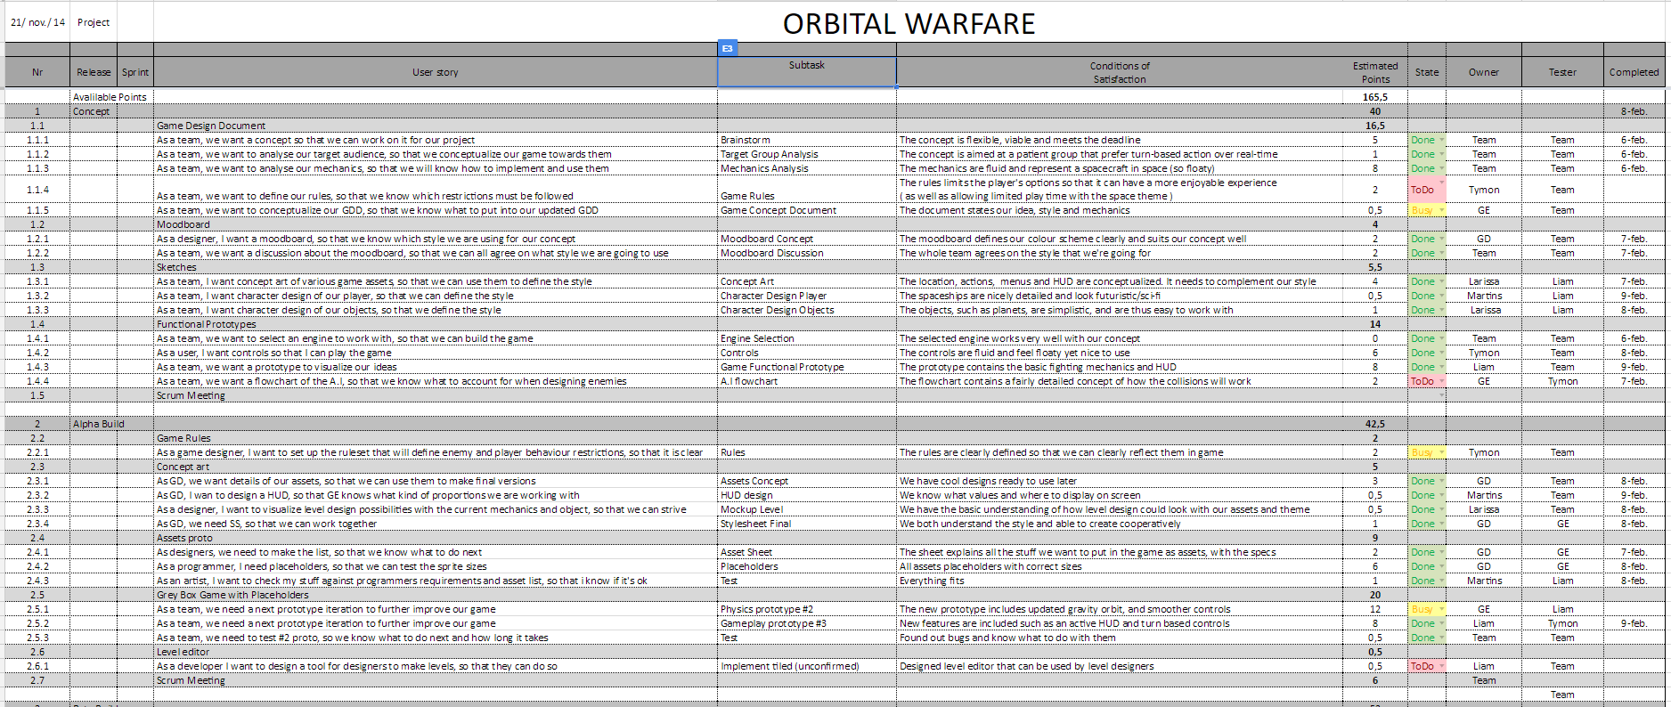
Planning

Slide 12
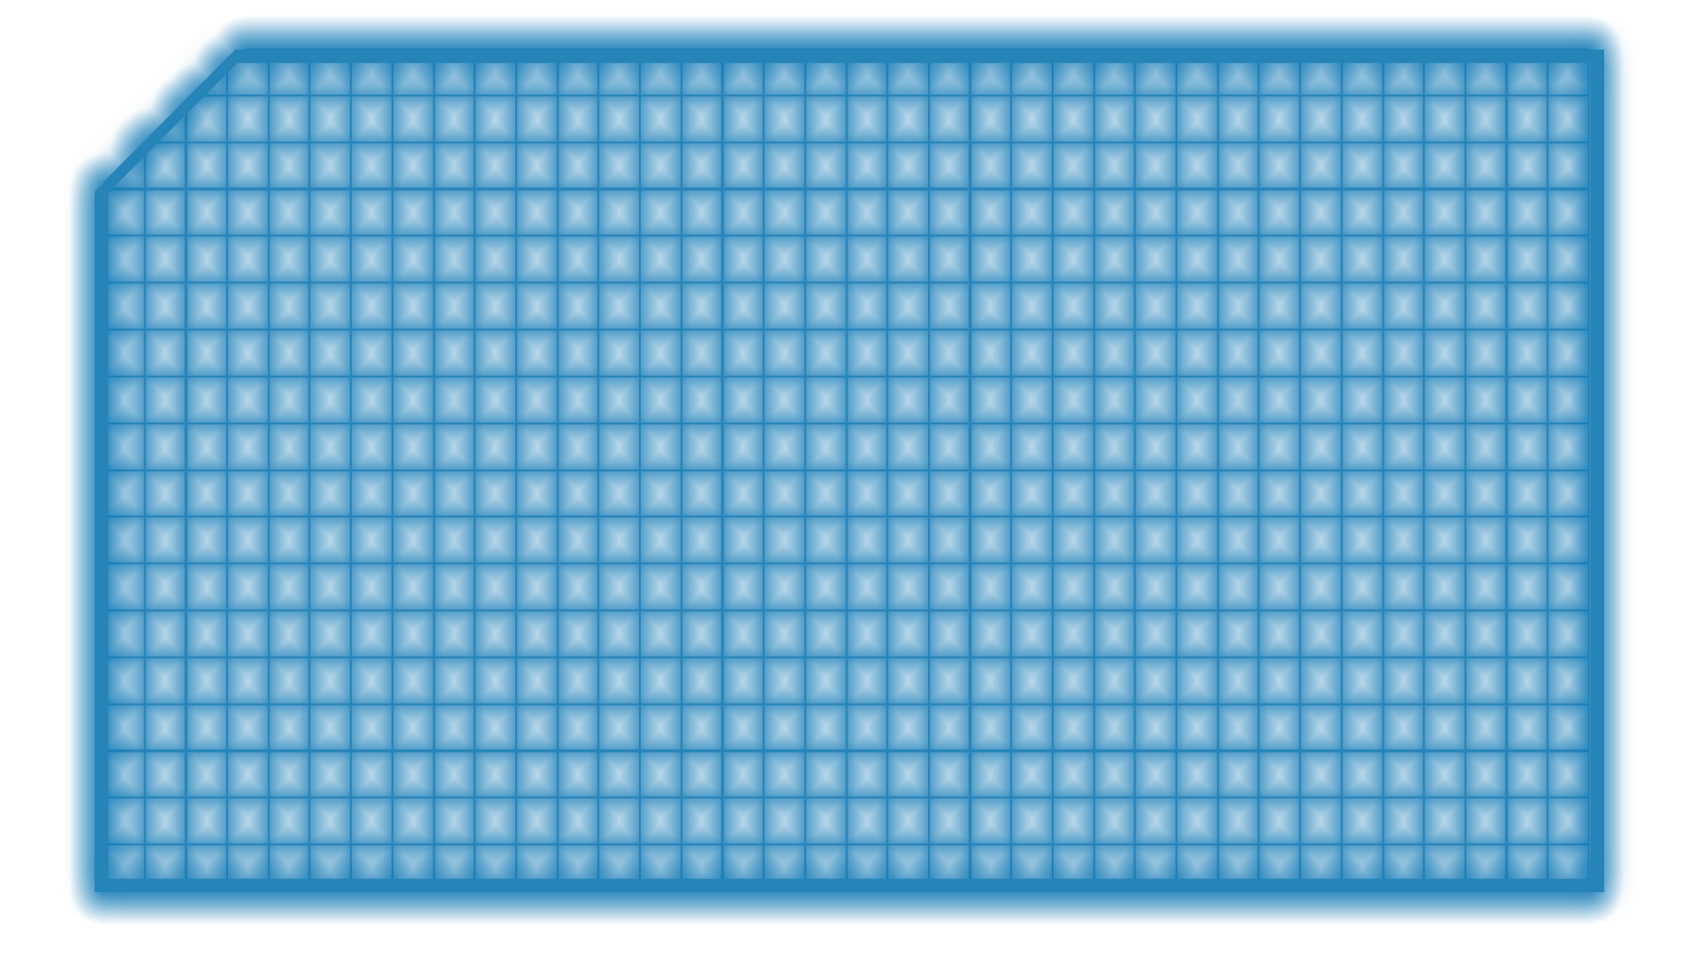
What did everyone do
Liam: HUD implementation, core game mechanics
Martins: UI design, player design, animations
Larissa: Planet design, BG art, audio and animations
Tymon: mechanics, Planet orbit, audio implementation
Daniel: core game mechanics, refactoring

Slide 13
Post mortem Martin
Learned a lot about task time estimates
Gained insight on team priority descisions
Could improve communication to reduce sidetracking

Slide 14
Post mortem Liam
Better understanding of vector usage
Learned to set priorities sooner for deadlines
Collaboration with other programmers has improved
Improved Github capabilities

Slide 15
Post mortem Larissa
Gained experience with audio and some new photoshop skills
Team could benefit from more consistent
communication and clearer seperation of work
and stand up phases
Gained some insight on the engineering part of the project
Generaly happy with the outcome

Slide 16
Post mortem Tymon
Team had good planing
The meeting times could have been more clear
Generaly group worked well

Slide 17
Post mortem Daniel
Experienced the difficulty of working in a new team that is using different code standards
Experienced the difficulty of joining a project late
Had to refresh my memories on linear algebra
In short projects it can be hard to decide, whether refactoring to a better structure worth the time
Gained some insight to the design side of the topic

Slide 18
Lessons learned as a team
Setting priorities and getting them done in time
Miscommunication w
Had to refresh my memories on linear algebra
In short projects it can be hard to decide, whether refactoring to a better structure worth the time
Gained some insight to the design side of the topic

Slide 19
Thank you for your attention!

